Slide 1



Introduction to Business Communication
Lesson 1: 07/10/22
Teacher Student Introduction
Ice Breaking Activity
Introduction to Business Communication
Challenging Someone’s ideas respectfully
Introduction to Graph Analysis

Slide 2

Important Dates
Im
Classes on 07/10; 28/10, 18/11 and 09/12
In Class graph description TP to be done in Week 3
Oral Presentation (TD) done in class in Week 4 in Groups of 3

Slide 3
Date | Lesson | Theme | Learning Outcomes/Objectives | Theme/Activities/Skills targeted | Resources
07/11/22 | 1 | The Importance of Workplace Communication | After completing this lesson students should be able to:- •discuss the importance of workplace communication •Respectfully challenge ideas using the correct phrases •Name different kinds of graphs •Describe graphs using the right vocabulary | •Introductions •Ice Breaker: Teacher led activity to get to know and remember each other’s names. •Creation of groups for the Mock Interviews •Read an article on fast changing job landscape and answer questions •Listen to a McKinsey video on the evolution of employment and AI | Listening and Role Play Activity: https://learnenglish.britishcouncil.org/skills/speaking/b2-speaking/challenging-someones-ideas Listening Activity https://youtu.be/g-9OL4UtqDs

Slide 4
Discussion
What is Communication and Why is it Important?

Slide 5
Listening for Detail
Listen to the video on the Importance of Workplace Communication
https://youtu.be/g-9OL4UtqDs

Slide 6
When You Don’t Agree: Communicating to Challenge Someone’s Ideas
Activity 1:
In this video, Vanya tells Paul and Emir about her latest idea. Listen to the language they use for challenging someone's ideas and practise saying the useful phrases.
https://learnenglish.britishcouncil.org/skills/speaking/b2-speaking/challenging-someones-ideas
Useful Phrases:
I'm a bit lost. What are you talking about?
Have you considered the fact that we're a branding agency, not a pet shop?
I take your point, but be imaginative.
I see where you're coming from.
I think I agree with Paul here.
How exactly do you see this working?
I'm very aware of the challenges here, but I'm convinced this will work.
You have to look at it from both sides.

Slide 7
When You Don’t Agree: Communicating to Challenge Someone’s Ideas
Activity 2:
In groups of 3, find a topic that you disagree about and use the phrases learnt to respectfully challenge the other person’s ideas.

Slide 8

Coffee Break

Slide 9
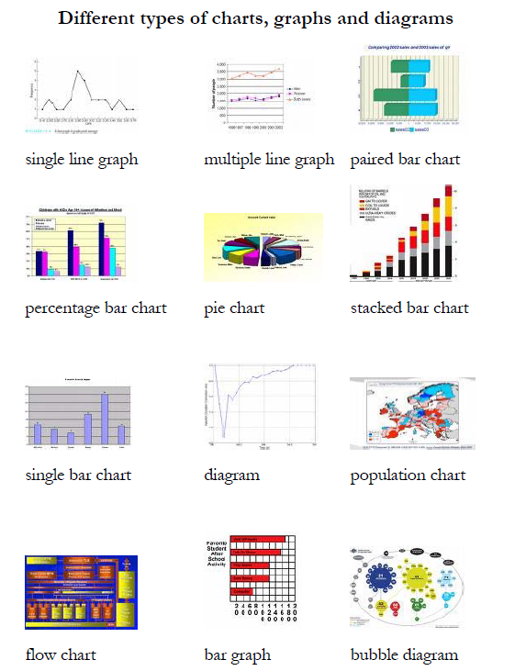
Introduction to Graph Analysis

Slide 10
Describing a graph - Identifying Trends
Most graphs will have two trends, or there will be two graphs with a trend in each. You could tell about the two trends in two separate paragraphs.
Introduction
First sentence: Describe the graph.
Second sentence: This gives the trend or trends.
Paragraph 1: Trend 1
Start with a sentence with no number. “City size increased sharply over the period.” “The most obvious trend in the graph is that women are having fewer babies.” “Oil production has increased slightly in all the countries in the graph”
Follow this sentence with an example (sentence with number) and perhaps another example (another sentence with number). Keep alternating.

Slide 11
Describing a graph - Identifying Trends
Identify trends.
Paragraph 2: Trend 2
Start with a sentence with no number.
Give an example (sentence with number) and perhaps another example
Conclusion
Finish by repeating the main trends. Use different vocabulary.
Don't have any numbers in the conclusion (you could use words like "most", "the majority" "a minority", "a small number").
Don’t give an opinion.

Slide 12
Describing a graph - The Don’ts
Don’t describe the X and Y axis. Give the information.
Don’t write about everything on the graph. Pick the biggest, the smallest, the main points, the main trends. Group similar things together
Don’t write about the line or the bar: “The line went up,” “The bar went down.” Instead, write about the idea. “The number of people going to work by train increased gradually.” “Oil production shot up in 1965”
Don’t use “I feel”, “as I have written,” “as you can see,” etc. Keep it academic.
Don’t start sentences with Conjunctions - But, So, Also, And, For, Since, Because, Although
Word Length
Make sure you have 150 words. You should have some short sentences (about 6-10 words) and some long ones (12-18) words, but your average should be about 12 or 13 words per sentence.
A sentence without a number will usually be short. Use a mix - a sentence without a number followed by a sentence or two with a number.

Slide 13
1. Naming Parts of the Graphs
the vertical axis represents
the horizontal axis represents
the curve
the solid line
the dotted line
the broken line
the shaded area
the unshaded section
the dotted column
the coloured segment
to read bar

Slide 14
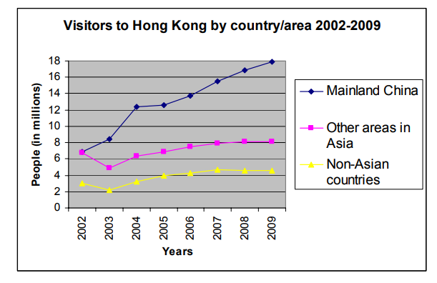
Sample 1

Slide 15
Sample 1
The graph shows the number of travellers from various parts of the world entering Hong Kong for the years from 2002 to 2009. It can clearly be seen that there has been a large increase in the number of Mainland Chinese visitors, while figures for visitors from Asia as well as other areas of the world have only shown a slight growth.
The numbers of Mainland Chinese visiting Hong Kong have risen considerably over this time period. In 2002 there were nearly 7 million Mainland Chinese visitors, similar to the figure for other parts of Asia and just over double that for non-Asian travelers. This number climbed to approximately 8 million in 2003, then rose dramatically by 4 million to just over 12 million only one year later. Since 2004 there has been a steady increase, with around 18 million Mainland Chinese travelers visiting Hong Kong in 2009. This is more than double the number for that year of other visitors from Asia, and around four times the figures for non-Asian visitors.
The figures for travellers from other parts of the world show similar trends: first a dip of roughly one-third the total number of visitors from 2002 to 2003, then slow growth until 2007 followed by a leveling out. Overall, the numbers of Asian tourists rose by 1 million from just under 7 million in 2002 to roughly 8 million seven years later, while the corresponding figures for visitors from non-Asian parts of the world were roughly 3 million and 4.5 million respectively.
To sum up, in recent years, Hong Kong has become an increasingly popular destination for visitors, especially people from mainland China who currently outnumber those from all other parts of the world combined.

Slide 17
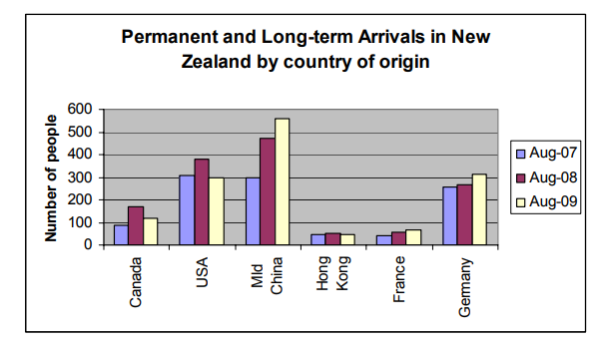
Sample 2

Slide 18
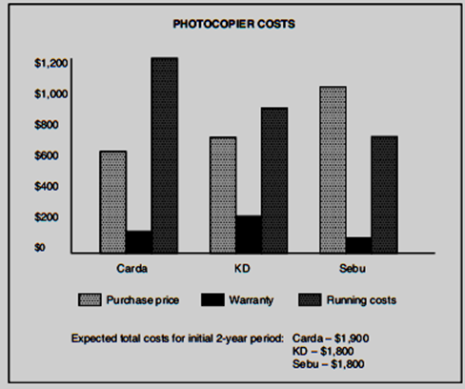
Sample 3

Slide 19
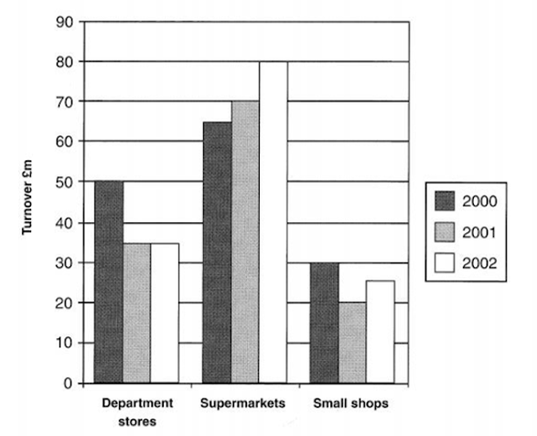
Sample 3

Slide 20
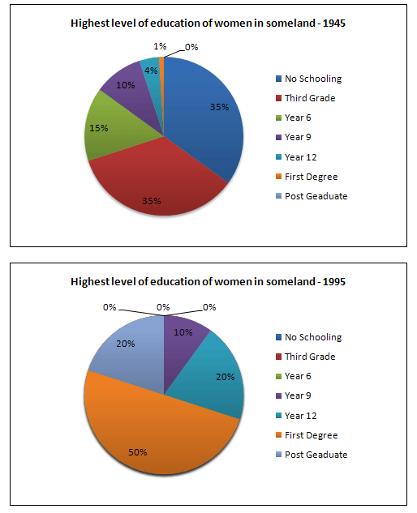
Sample 4

Slide 21

The End.
Thank you for your time

